Slide 1
DATABASE MANAGEMENT SYSTEMS · REVIEW 1
Gym Membership & Fitness Session Management System
Design and implementation of a relational database, normalized to Third Normal Form.
PRESENTED BY
ROLL NO.
SECTION
Aryan Baswapur
3007
BIC-Tigers-29
Notes:
Good morning. This is my Review 1 for the Gym Membership and Fitness Session Management System — the design of a relational database taken from requirements through the ER model to an initial schema.

Slide 2

01
Expiry goes unnoticed
Memberships lapse with no alert, so revenue leaks and lapsed members keep training.
PROBLEM IDENTIFICATION
Why manual systems fall short
02
Most fitness centres track members, subscriptions, trainers, classes and equipment on spreadsheets and paper registers.
Classes overbook
No capacity control means sessions are double-booked and trainers are assigned to overlapping slots.
Without enforced rules, data drifts out of sync and the errors below go unnoticed until they cost money or a member's trust.
03
Records scatter
Assessments, payments and equipment logs live in separate files with no shared source of truth.
Notes:
Fitness centres run on spreadsheets and paper. Three failures repeat: expiries slip by, classes overbook, and records scatter across files. A single database with rules built in fixes all three.

Slide 3
SCOPE & OBJECTIVES
What the system will and must do
In Scope
Objectives
Members, plans & subscriptions
01
Model gym data as a normalized relational schema in 3NF.
Trainers, assessments & workout programmes
Classes, schedules, registrations & attendance
02
Protect integrity with primary keys, foreign keys and constraints.
Equipment & maintenance
Automate expiry, class-capacity and trainer-overlap rules.
03
Payments, renewals & reporting
04
Deliver queries and reports for members, revenue and trainer load.
Notes:
The scope covers the full member lifecycle plus trainers, classes, equipment and money. The objectives are the four things the database must actually deliver.

Slide 4
USERS & FUNCTIONAL REQUIREMENTS
Who uses it, and what it must do
Administrator
Front-desk
Trainer
Member
Plans, staff, config & reports
Sign-ups, bookings, payments
Assessments, programmes, classes
Book classes, track progress
Membership & Plans
Subscriptions & Renewals
Trainers & Assessments
Register members, assign and upgrade plans.
Activate, track expiry and renew on time.
Assign trainers, record fitness assessments.
Classes & Booking
Attendance
Payments & Reporting
Schedule classes, book seats within capacity.
Mark check-in and check-out per session.
Record payments, generate revenue & load reports.
Notes:
Four user roles, each with its own view of the system, and the functional modules the database has to support underneath them.

Slide 5
CONCEPTUAL DESIGN
The fourteen principal entities
MEMBERSHIP
TRAINING
ACTIVITY & OPERATIONS
Member
Trainer
Registration
Plan
Assessment
Attendance
Subscription
Workout Programme
Equipment
Payment
Class
Maintenance
Renewal
Schedule
Notes:
Fourteen entities, grouped into three domains — the membership side, the training side, and operations. These become the tables of the schema.

Slide 6
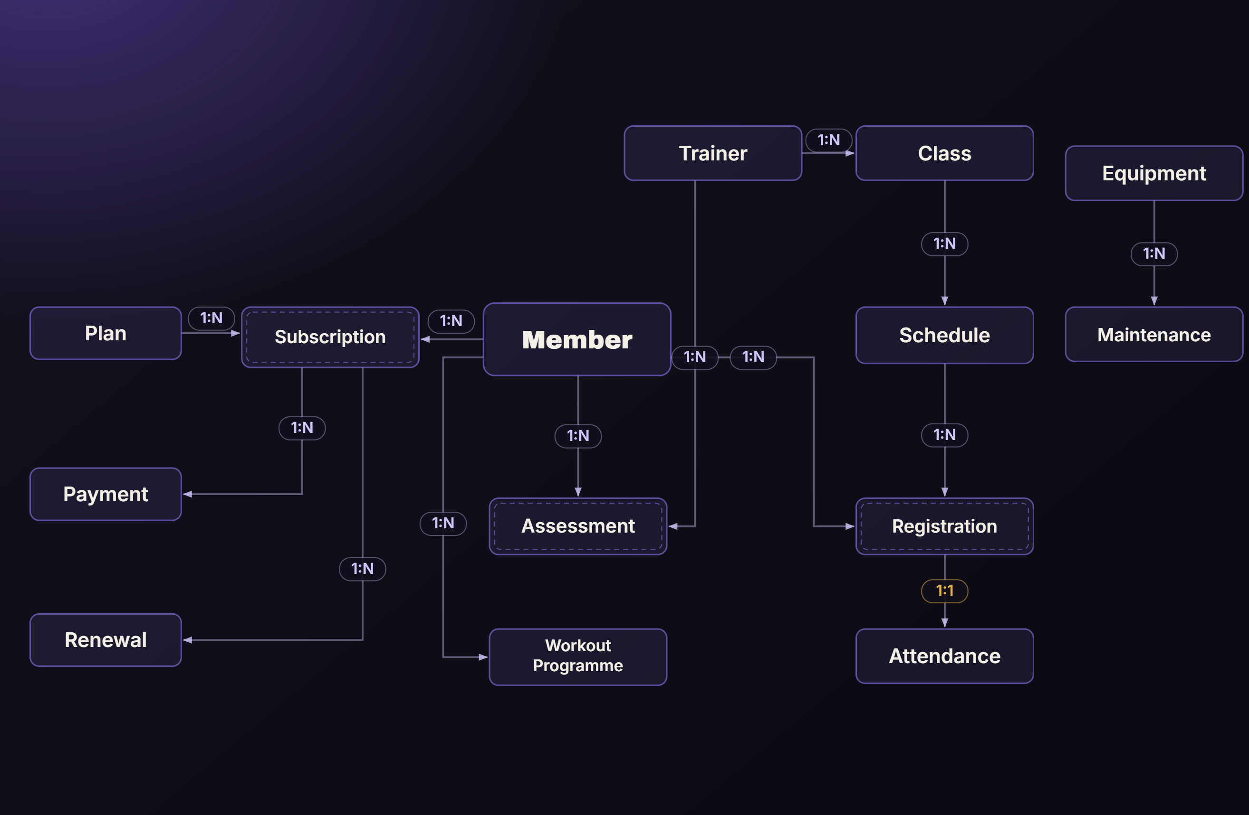
CONCEPTUAL DESIGN
Arrow points 1 → N (one-to-many) Dashed inner border = associative entity
Entity–Relationship model
KEY RELATIONSHIPS
Member → Subscription
1 : N
Plan → Subscription
1 : N
Subscription → Payment
1 : N
Subscription → Renewal
1 : N
Member ↔ Class
M : N
Class → Schedule
1 : N
Trainer → Class
1 : N
Trainer / Member → Assessment
1 : N
Equipment → Maintenance
1 : N
Member ↔ Class is resolved through Registration ; each registration has a 1:1 Attendance record.
Associative (junction) entity
1:N one-to-many · M:N many-to-many
Notes:
This is the conceptual ER model, read from the central Member entity outwards. Entities are grouped into three domains — membership, training and operations — and Subscription, Assessment and Registration are associative (junction) entities, shown with a dashed inner border, which exist only to link two other entities. MEMBERSHIP: a Member (member_id, name, phone, email, date of birth, join date) takes out a Subscription, which is the junction between a Member and a Plan — one member holds many subscriptions over time and one plan is chosen by many subscriptions, so both are one-to-many into Subscription. The Subscription carries start date, end date and status, and is the parent of two records — Payment (amount, method, paid-on date) and Renewal (renewal date, new end date) — each one-to-many from Subscription. TRAINING: a Trainer (trainer_id, name, specialization, shift) leads many Classes and conducts many Assessments. A Class (class_id, title, capacity, room) is offered as many Schedules (day, start time, end time), so Class-to-Schedule is one-to-many. An Assessment (date, weight, BMI, body-fat) is the junction between a Member and a Trainer — both one-to-many into it — and a Member also follows one or more Workout Programmes. OPERATIONS: the key many-to-many is Member-to-Class — a member joins many classes and a class holds many members — resolved through the Registration junction, which links a Member to a specific Schedule with a booking date and status. Each Registration then has a one-to-one Attendance record capturing check-in and check-out. Finally, Equipment (name, category, purchase date, status) has many Maintenance logs (service date, cost) — a one-to-many that is independent of the member-facing side. The panel on the right summarises all nine major relationships with their cardinalities.

Slide 7
CONCEPTUAL DESIGN
Core entities & key attributes
ENTITY
KEY ATTRIBUTES (PRIMARY KEY UNDERLINED)
Member
member_id, name, phone, email, dob, join_date
Plan
plan_id, name, duration_months, price, features
Subscription
subscription_id, member_id, plan_id, start_date, end_date, status
Trainer
trainer_id, name, specialization, shift, phone
Assessment
assessment_id, member_id, trainer_id, date, weight, bmi, body_fat
Class
class_id, trainer_id, title, capacity, room
Schedule
schedule_id, class_id, day, start_time, end_time
Registration
registration_id, member_id, schedule_id, booking_date, status
Attendance
attendance_id, registration_id, check_in, check_out
Payment
payment_id, subscription_id, amount, method, paid_on
Equipment
equipment_id, name, category, purchase_date, status · Maintenance: maintenance_id, equipment_id, date, cost
Notes:
The key attributes of each core entity, with the primary key underlined. These are the columns that carry into the relational schema.

Slide 8
INITIAL RELATIONAL SCHEMA · MYSQL
Tables, primary & foreign keys
MEMBER
PLAN
SUBSCRIPTION
member_id
PK
plan_id
PK
subscription_id
PK
name, phone, email
name, duration_months
member_id FK plan_id FK
dob, join_date
price, features
start_date, end_date, status
CLASS
REGISTRATION
PAYMENT
class_id
PK
registration_id
PK
payment_id
PK
trainer_id FK
member_id FK schedule_id FK
subscription_id FK
title, capacity, room
booking_date, status
amount, method, paid_on
PK · FK · UNIQUE(email, phone) · NOT NULL · CHECK(price ≥ 0, capacity > 0, end_date > start_date) · DEFAULT(status='ACTIVE')
CONSTRAINTS
NORMALIZED
to 3NF — no partial or transitive dependencies
+ Trainer, Assessment, Schedule, Attendance, Equipment, Maintenance, Renewal and Workout_Programme tables follow the same key pattern.
Notes:
The ER model converted to relational tables. Each has a primary key, and foreign keys wire the relationships together. The remaining tables follow the same pattern. Everything is normalized to third normal form, with the integrity and business constraints listed at the bottom.

Slide 9



REVIEW 1 · CONCEPTUAL DESIGN COMPLETE
Thank You
Aryan Baswapur
Roll No. 3007
Section BIC-Tigers-29
Notes:
That completes Review 1 — problem and scope, users and requirements, the ER model, entities and attributes, and the initial relational schema. Thank you, I'm happy to take questions.

